Slide 1
Fractions of amounts
How do I determine the fraction of an amount or share an amount amongst a number of people?

Slide 2
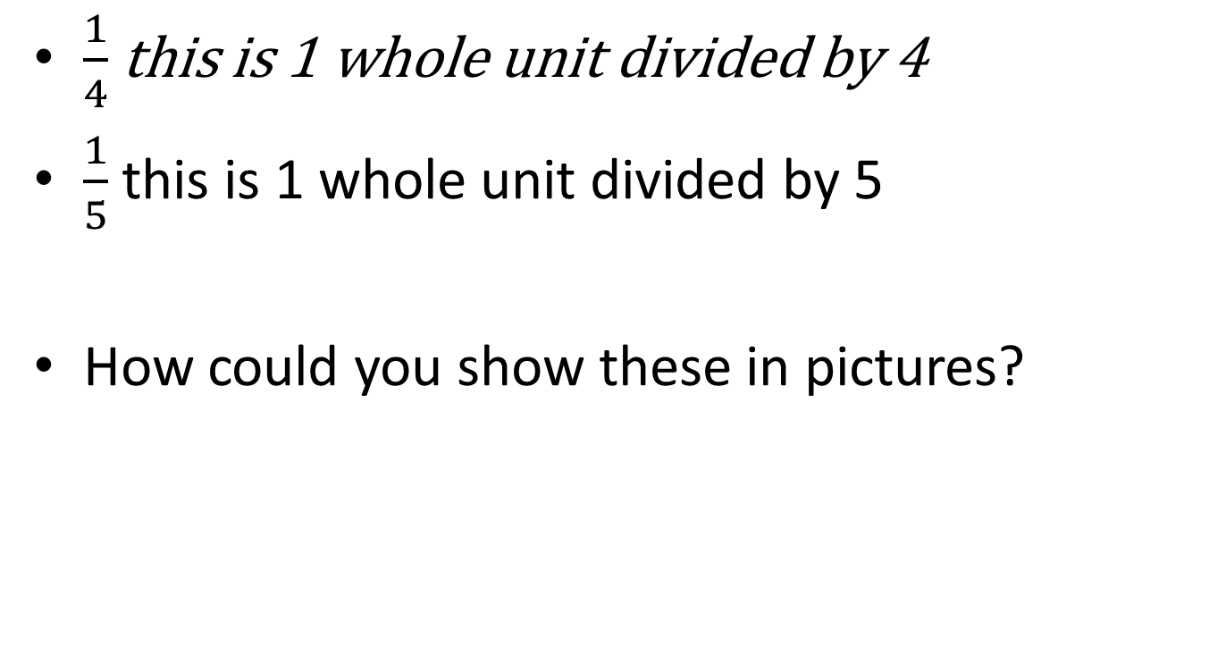
fractions
$\frac{1}{4}$ this is 1 whole unit divided by 4
$\frac{1}{5}$ this is 1 whole unit divided by 5
How could you show these in pictures?

Slide 3
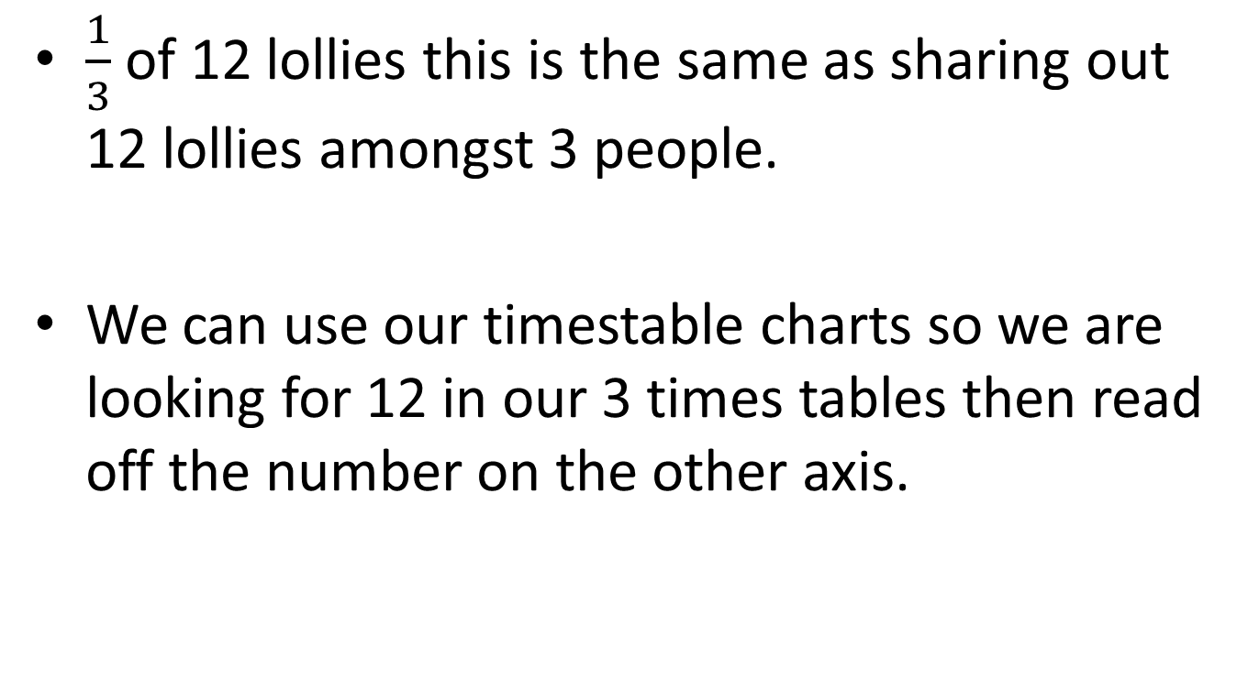
Fraction of an amount
$\frac{1}{3}$ of 12 lollies this is the same as sharing out 12 lollies amongst 3 people.
We can use our timestable charts so we are looking for 12 in our 3 times tables then read off the number on the other axis.

Slide 4

Division
This is known as division.
21 ÷ 3 = $\frac{1}{3}$ of 21 = one third of 21=
55 ÷ 5 =
48 ÷ 6 =
28 ÷ 4 =

Slide 5
Quick write
Write in your own words how you will use your times table chart for division.

Slide 6
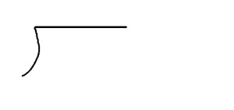

What about dividing with bigger numbers?
$\frac{1}{3}$ of $822
Remember to use your timestable chart to help you.
3
822

